Slide 1
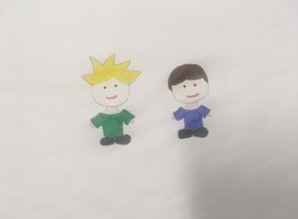

Slide 2
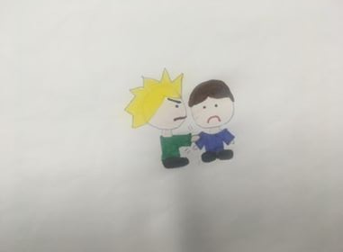

Slide 3
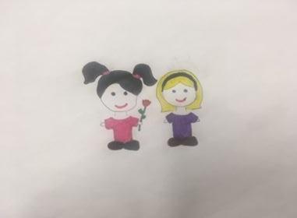

Slide 4
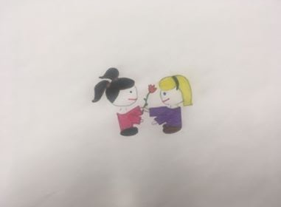

Slide 5
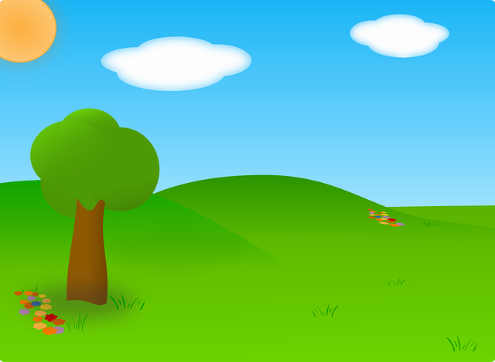

Notes:
Secret #3 – Flowers
But if all of the kids picked flowers, then there would be no more flowers growing in the park

Slide 6



Notes:
Secret #3 – Flowers
But if all of the kids picked flowers, then there would be no more flowers growing in the park

Slide 7
Notes:
Secret #3 – Flowers
But if all of the kids picked flowers, then there would be no more flowers growing in the park

Slide 8
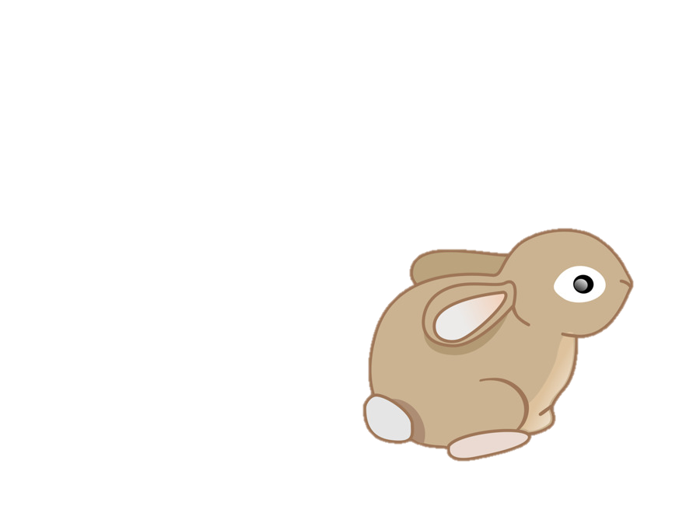
Notes:
Secret #3 – Flowers
But if all of the kids picked flowers, then there would be no more flowers growing in the park

Slide 9


Notes:
Secret #3 – Flowers
But if all of the kids picked flowers, then there would be no more flowers growing in the park

Slide 10
high

Slide 11




Notes:
Secret #2 - Buckets
This is a story about Mary. Mary and her friends are at the lake. The fish in the lake love swimming in the lake water. Mary goes behind a tree, where no one else can see her, and she fills a bucket with water from the lake. If she fills the bucket with lake water, she will get to take it home to her goldfish. But if everyone filled a bucket with water from the lake, then there would be no more water in the lake.

Slide 12

Notes:
Secret #2 - Buckets
This is a story about Mary. Mary and her friends are at the lake. The fish in the lake love swimming in the lake water. Mary goes behind a tree, where no one else can see her, and she fills a bucket with water from the lake. If she fills the bucket with lake water, she will get to take it home to her goldfish. But if everyone filled a bucket with water from the lake, then there would be no more water in the lake.

Slide 13

Notes:
Secret #2 - Buckets
This is a story about Mary. Mary and her friends are at the lake. The fish in the lake love swimming in the lake water. Mary goes behind a tree, where no one else can see her, and she fills a bucket with water from the lake. If she fills the bucket with lake water, she will get to take it home to her goldfish. But if everyone filled a bucket with water from the lake, then there would be no more water in the lake.

Slide 14
Notes:
Secret #2 - Buckets
This is a story about Mary. Mary and her friends are at the lake. The fish in the lake love swimming in the lake water. Mary goes behind a tree, where no one else can see her, and she fills a bucket with water from the lake. If she fills the bucket with lake water, she will get to take it home to her goldfish. But if everyone filled a bucket with water from the lake, then there would be no more water in the lake.

Slide 15
Notes:
Secret #2 - Buckets
This is a story about Mary. Mary and her friends are at the lake. The fish in the lake love swimming in the lake water. Mary goes behind a tree, where no one else can see her, and she fills a bucket with water from the lake. If she fills the bucket with lake water, she will get to take it home to her goldfish. But if everyone filled a bucket with water from the lake, then there would be no more water in the lake.

Slide 16

Notes:
Secret #2 - Buckets
This is a story about Mary. Mary and her friends are at the lake. The fish in the lake love swimming in the lake water. Mary goes behind a tree, where no one else can see her, and she fills a bucket with water from the lake. If she fills the bucket with lake water, she will get to take it home to her goldfish. But if everyone filled a bucket with water from the lake, then there would be no more water in the lake.

Slide 17
Notes:
Secret #2 - Buckets
This is a story about Mary. Mary and her friends are at the lake. The fish in the lake love swimming in the lake water. Mary goes behind a tree, where no one else can see her, and she fills a bucket with water from the lake. If she fills the bucket with lake water, she will get to take it home to her goldfish. But if everyone filled a bucket with water from the lake, then there would be no more water in the lake.

Slide 18

Notes:
Secret #2 - Buckets
This is a story about Mary. Mary and her friends are at the lake. The fish in the lake love swimming in the lake water. Mary goes behind a tree, where no one else can see her, and she fills a bucket with water from the lake. If she fills the bucket with lake water, she will get to take it home to her goldfish. But if everyone filled a bucket with water from the lake, then there would be no more water in the lake.

Slide 19
Notes:
Secret #2 - Buckets
This is a story about Mary. Mary and her friends are at the lake. The fish in the lake love swimming in the lake water. Mary goes behind a tree, where no one else can see her, and she fills a bucket with water from the lake. If she fills the bucket with lake water, she will get to take it home to her goldfish. But if everyone filled a bucket with water from the lake, then there would be no more water in the lake.

Slide 20

Notes:
Secret #2 - Buckets
This is a story about Mary. Mary and her friends are at the lake. The fish in the lake love swimming in the lake water. Mary goes behind a tree, where no one else can see her, and she fills a bucket with water from the lake. If she fills the bucket with lake water, she will get to take it home to her goldfish. But if everyone filled a bucket with water from the lake, then there would be no more water in the lake.

Slide 21
Notes:
Secret #2 - Buckets
This is a story about Mary. Mary and her friends are at the lake. The fish in the lake love swimming in the lake water. Mary goes behind a tree, where no one else can see her, and she fills a bucket with water from the lake. If she fills the bucket with lake water, she will get to take it home to her goldfish. But if everyone filled a bucket with water from the lake, then there would be no more water in the lake.

Slide 22
Notes:
Secret #2 - Buckets
This is a story about Mary. Mary and her friends are at the lake. The fish in the lake love swimming in the lake water. Mary goes behind a tree, where no one else can see her, and she fills a bucket with water from the lake. If she fills the bucket with lake water, she will get to take it home to her goldfish. But if everyone filled a bucket with water from the lake, then there would be no more water in the lake.

Slide 23
Notes:
Secret #2 - Buckets
This is a story about Mary. Mary and her friends are at the lake. The fish in the lake love swimming in the lake water. Mary goes behind a tree, where no one else can see her, and she fills a bucket with water from the lake. If she fills the bucket with lake water, she will get to take it home to her goldfish. But if everyone filled a bucket with water from the lake, then there would be no more water in the lake.

Slide 24
Notes:
Secret #2 - Buckets
This is a story about Mary. Mary and her friends are at the lake. The fish in the lake love swimming in the lake water. Mary goes behind a tree, where no one else can see her, and she fills a bucket with water from the lake. If she fills the bucket with lake water, she will get to take it home to her goldfish. But if everyone filled a bucket with water from the lake, then there would be no more water in the lake.

Slide 25
Notes:
Secret #2 - Buckets
This is a story about Mary. Mary and her friends are at the lake. The fish in the lake love swimming in the lake water. Mary goes behind a tree, where no one else can see her, and she fills a bucket with water from the lake. If she fills the bucket with lake water, she will get to take it home to her goldfish. But if everyone filled a bucket with water from the lake, then there would be no more water in the lake.

Slide 26
Low interest

Slide 27
Notes:
Secret #2 - Buckets
This is a story about Mary. Mary and her friends are at the lake. The fish in the lake love swimming in the lake water. Mary goes behind a tree, where no one else can see her, and she fills a bucket with water from the lake. If she fills the bucket with lake water, she will get to take it home to her goldfish. But if everyone filled a bucket with water from the lake, then there would be no more water in the lake.

Slide 28
Notes:
Secret #2 - Buckets
This is a story about Mary. Mary and her friends are at the lake. The fish in the lake love swimming in the lake water. Mary goes behind a tree, where no one else can see her, and she fills a bucket with water from the lake. If she fills the bucket with lake water, she will get to take it home to her goldfish. But if everyone filled a bucket with water from the lake, then there would be no more water in the lake.

Slide 29
Notes:
Secret #2 - Buckets
This is a story about Mary. Mary and her friends are at the lake. The fish in the lake love swimming in the lake water. Mary goes behind a tree, where no one else can see her, and she fills a bucket with water from the lake. If she fills the bucket with lake water, she will get to take it home to her goldfish. But if everyone filled a bucket with water from the lake, then there would be no more water in the lake.

Slide 30
Notes:
Secret #2 - Buckets
This is a story about Mary. Mary and her friends are at the lake. The fish in the lake love swimming in the lake water. Mary goes behind a tree, where no one else can see her, and she fills a bucket with water from the lake. If she fills the bucket with lake water, she will get to take it home to her goldfish. But if everyone filled a bucket with water from the lake, then there would be no more water in the lake.

Slide 31
Notes:
Secret #2 - Buckets
This is a story about Mary. Mary and her friends are at the lake. The fish in the lake love swimming in the lake water. Mary goes behind a tree, where no one else can see her, and she fills a bucket with water from the lake. If she fills the bucket with lake water, she will get to take it home to her goldfish. But if everyone filled a bucket with water from the lake, then there would be no more water in the lake.

Slide 32
Notes:
Secret #2 - Buckets
This is a story about Mary. Mary and her friends are at the lake. The fish in the lake love swimming in the lake water. Mary goes behind a tree, where no one else can see her, and she fills a bucket with water from the lake. If she fills the bucket with lake water, she will get to take it home to her goldfish. But if everyone filled a bucket with water from the lake, then there would be no more water in the lake.

Slide 33
Notes:
Secret #2 - Buckets
This is a story about Mary. Mary and her friends are at the lake. The fish in the lake love swimming in the lake water. Mary goes behind a tree, where no one else can see her, and she fills a bucket with water from the lake. If she fills the bucket with lake water, she will get to take it home to her goldfish. But if everyone filled a bucket with water from the lake, then there would be no more water in the lake.

Slide 34
Notes:
Secret #2 - Buckets
This is a story about Mary. Mary and her friends are at the lake. The fish in the lake love swimming in the lake water. Mary goes behind a tree, where no one else can see her, and she fills a bucket with water from the lake. If she fills the bucket with lake water, she will get to take it home to her goldfish. But if everyone filled a bucket with water from the lake, then there would be no more water in the lake.

Slide 35
Notes:
Secret #2 - Buckets
This is a story about Mary. Mary and her friends are at the lake. The fish in the lake love swimming in the lake water. Mary goes behind a tree, where no one else can see her, and she fills a bucket with water from the lake. If she fills the bucket with lake water, she will get to take it home to her goldfish. But if everyone filled a bucket with water from the lake, then there would be no more water in the lake.

Slide 36
Notes:
Secret #2 - Buckets
This is a story about Mary. Mary and her friends are at the lake. The fish in the lake love swimming in the lake water. Mary goes behind a tree, where no one else can see her, and she fills a bucket with water from the lake. If she fills the bucket with lake water, she will get to take it home to her goldfish. But if everyone filled a bucket with water from the lake, then there would be no more water in the lake.

Slide 37
Notes:
Secret #2 - Buckets
This is a story about Mary. Mary and her friends are at the lake. The fish in the lake love swimming in the lake water. Mary goes behind a tree, where no one else can see her, and she fills a bucket with water from the lake. If she fills the bucket with lake water, she will get to take it home to her goldfish. But if everyone filled a bucket with water from the lake, then there would be no more water in the lake.

Slide 38
Notes:
Secret #2 - Buckets
This is a story about Mary. Mary and her friends are at the lake. The fish in the lake love swimming in the lake water. Mary goes behind a tree, where no one else can see her, and she fills a bucket with water from the lake. If she fills the bucket with lake water, she will get to take it home to her goldfish. But if everyone filled a bucket with water from the lake, then there would be no more water in the lake.

Slide 39
Notes:
Secret #2 - Buckets
This is a story about Mary. Mary and her friends are at the lake. The fish in the lake love swimming in the lake water. Mary goes behind a tree, where no one else can see her, and she fills a bucket with water from the lake. If she fills the bucket with lake water, she will get to take it home to her goldfish. But if everyone filled a bucket with water from the lake, then there would be no more water in the lake.

Slide 40
Notes:
Secret #2 - Buckets
This is a story about Mary. Mary and her friends are at the lake. The fish in the lake love swimming in the lake water. Mary goes behind a tree, where no one else can see her, and she fills a bucket with water from the lake. If she fills the bucket with lake water, she will get to take it home to her goldfish. But if everyone filled a bucket with water from the lake, then there would be no more water in the lake.

Slide 41
high

Slide 42


Notes:
This is a story about Jacob. Jacob and the other kids walk through a park to get home. There are rocks on the paths so people can walk without getting their shoes muddy.

Slide 43

Notes:
This is a story about Jacob. Jacob and the other kids walk through a park to get home. There are rocks on the paths so people can walk without getting their shoes muddy.

Slide 44
Notes:
This is a story about Jacob. Jacob and the other kids walk through a park to get home. There are rocks on the paths so people can walk without getting their shoes muddy.

Slide 45
Notes:
This is a story about Jacob. Jacob and the other kids walk through a park to get home. There are rocks on the paths so people can walk without getting their shoes muddy.

Slide 46
Notes:
This is a story about Jacob. Jacob and the other kids walk through a park to get home. There are rocks on the paths so people can walk without getting their shoes muddy.

Slide 47
Notes:
This is a story about Jacob. Jacob and the other kids walk through a park to get home. There are rocks on the paths so people can walk without getting their shoes muddy.

Slide 48
Notes:
This is a story about Jacob. Jacob and the other kids walk through a park to get home. There are rocks on the paths so people can walk without getting their shoes muddy.

Slide 49
Notes:
This is a story about Jacob. Jacob and the other kids walk through a park to get home. There are rocks on the paths so people can walk without getting their shoes muddy.

Slide 50

Notes:
This is a story about Jacob. Jacob and the other kids walk through a park to get home. There are rocks on the paths so people can walk without getting their shoes muddy.

Slide 51
Notes:
This is a story about Jacob. Jacob and the other kids walk through a park to get home. There are rocks on the paths so people can walk without getting their shoes muddy.

Slide 52
Notes:
This is a story about Jacob. Jacob and the other kids walk through a park to get home. There are rocks on the paths so people can walk without getting their shoes muddy.

Slide 53
Notes:
This is a story about Jacob. Jacob and the other kids walk through a park to get home. There are rocks on the paths so people can walk without getting their shoes muddy.

Slide 54
Notes:
This is a story about Jacob. Jacob and the other kids walk through a park to get home. There are rocks on the paths so people can walk without getting their shoes muddy.

Slide 55
Notes:
This is a story about Jacob. Jacob and the other kids walk through a park to get home. There are rocks on the paths so people can walk without getting their shoes muddy.

Slide 56
Limited Interest

Slide 57
Notes:
This is a story about Jacob. Jacob and the other kids walk through a park to get home. There are rocks on the paths so people can walk without getting their shoes muddy.

Slide 58
Notes:
This is a story about Jacob. Jacob and the other kids walk through a park to get home. There are rocks on the paths so people can walk without getting their shoes muddy.

Slide 59
Notes:
This is a story about Jacob. Jacob and the other kids walk through a park to get home. There are rocks on the paths so people can walk without getting their shoes muddy.

Slide 60
Notes:
This is a story about Jacob. Jacob and the other kids walk through a park to get home. There are rocks on the paths so people can walk without getting their shoes muddy.

Slide 61
Notes:
This is a story about Jacob. Jacob and the other kids walk through a park to get home. There are rocks on the paths so people can walk without getting their shoes muddy.

Slide 62
Notes:
This is a story about Jacob. Jacob and the other kids walk through a park to get home. There are rocks on the paths so people can walk without getting their shoes muddy.

Slide 63
Notes:
This is a story about Jacob. Jacob and the other kids walk through a park to get home. There are rocks on the paths so people can walk without getting their shoes muddy.

Slide 64
Notes:
This is a story about Jacob. Jacob and the other kids walk through a park to get home. There are rocks on the paths so people can walk without getting their shoes muddy.

Slide 65
Notes:
This is a story about Jacob. Jacob and the other kids walk through a park to get home. There are rocks on the paths so people can walk without getting their shoes muddy.

Slide 66
Notes:
This is a story about Jacob. Jacob and the other kids walk through a park to get home. There are rocks on the paths so people can walk without getting their shoes muddy.

Slide 67
Notes:
This is a story about Jacob. Jacob and the other kids walk through a park to get home. There are rocks on the paths so people can walk without getting their shoes muddy.

Slide 68
Notes:
This is a story about Jacob. Jacob and the other kids walk through a park to get home. There are rocks on the paths so people can walk without getting their shoes muddy.

Slide 69
Notes:
This is a story about Jacob. Jacob and the other kids walk through a park to get home. There are rocks on the paths so people can walk without getting their shoes muddy.

Slide 70
Notes:
This is a story about Jacob. Jacob and the other kids walk through a park to get home. There are rocks on the paths so people can walk without getting their shoes muddy.

